Slide 1

React Language Translator
BUILT USING REACT + AXIOS + LIBRETRANSLATE API
UMUNNAKWE BRILLIANT CHIMUDIEBUBE
VUG/SEN/24/11369
16/06/2025

Slide 2
WHAT IS THE PROJECT
Create a web app that translates English text into other languages.
Uses React for the frontend and Axios to communicate with the translator API.
Help users understand or convert text in real time.

Slide 3
Tools Used
React: for building the user interface.
Axios: for making HTTP requests.
LibreTranslate: for translation.
Javascript: programming logic.
HTML/CSS: for layout and styling.

Slide 4
How it works(process)
User enters text in English.
User clicks “Translate”.
App sends the text to the API using Axios.
API returns the translated text.
Translated text is shown on the page.

Slide 5
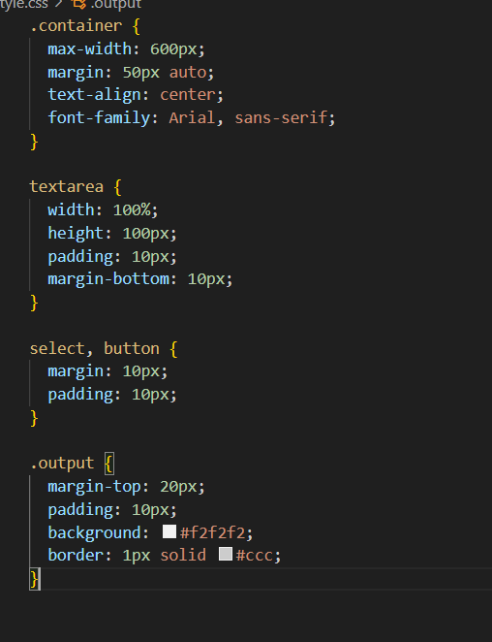
Core Code Breakdown
State setup using usestate.
HandleTranslate function (async/await + Axios)
Text input,button,and result display

Slide 6
LibreTranslate API
URL used:
https://libretranslate.de/translate
Method: POST
JSON body fields:
- q: text to translate
- Source: original language(e.g.,”en”)
-target:target language(e.g.,”es”)
Response: returns translated_text

Slide 7
Problems
The website of the code is not responsive,that’s why when you press translate it cannot translate because of the site.
CORS errors (fixed by using .de instead of .com)
Axios errors or missing translated_text field.
Underastanding async/await logic.
Designing a clean UI wityh React.

Slide 8
What I Learned
How to make use of Axios to make API calls.
Handling async code with async/await.
Working with React state (useState).
Reading and using API documentation.
Building real-world apps in React.

Slide 9
What’s Next?
Add language dropdown (more languages)
Add voice input or text-to-speech
Fixing the error of the site to make it responsive
Make it mobile responsive
Deploy it to Netlify or Vercel
Store recent translations

